Slide 1


BAN6800: Business Analytics Capstone
Milstone 1 Assignment: Business Analytics Project-Ready Dataset
Name: Kamal Usman Oyeyinka
Learner ID: 153860

Slide 2

Project Overview
Business Problem:
High readmission rates in patients result in high health costs and low quality of care.
Objective
Application of machine learning for the purpose of predicting readmission risk and increasing healthcare efficiency.

Slide 3
Data Sources & Collection Methods
Data Source:
Kaggle dataset on hospital readmissions
Data Type:
Patient visit details
Medical history
Lab results
Medications
Readmission status
Collection Method:
Downloaded structured dataset from Kaggle

Slide 4
Data Cleaning Process
Steps Taken:
Removed duplicates
Handled missing values (numerical → median, categorical → mode)
Standardized categorical values (one-hot encoding for gender, admission type)

Slide 5
Feature Engineering & Data Transformation
New Features Created:
total_visits = outpatient + emergency + inpatient visits
Converted 'age' from categorical to numerical format
Normalization Applied:
MinMaxScaler applied to Age & Hospital Stay Duration

Slide 6
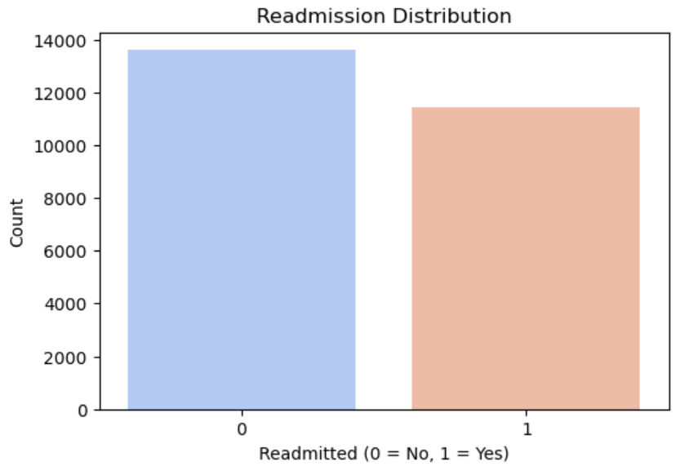
Exploratory Data Analysis (EDA) - Readmission Distribution
Analysis:
Bar chart showing the proportion of readmitted vs. non-readmitted patients
Key trends from the dataset

Slide 7
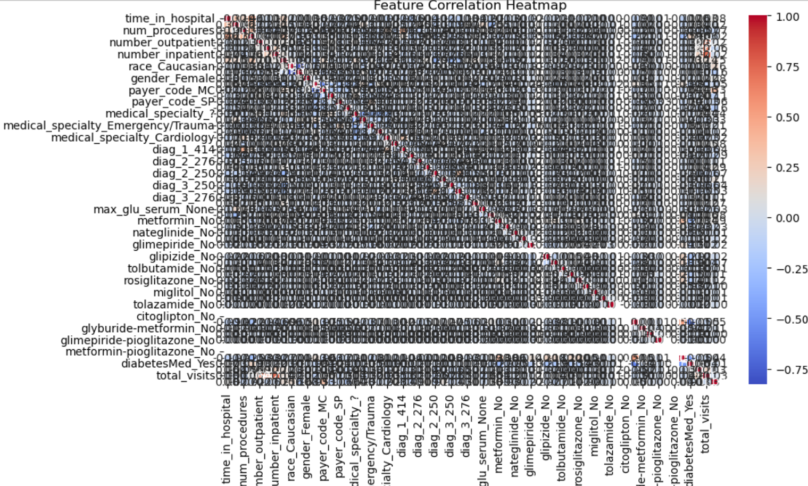
EDA - Correlation Analysis
Analysis:
Heatmap of feature correlations
Identified key predictors of patient readmission

Slide 8
Final Cleaned Dataset
Dataset Storage:
Cleaned and ready for analysis
Uploaded to GitHub
GitHub link for the dataset:
https://github.com/YinkaKamal/BusinessAnalytics_Capstone/blob/main/cleaned_hospital_readmissions.csv

Slide 9
Jupyter Notebook for EDA
Python Notebook:
Contains all preprocessing and EDA steps
Uploaded to GitHub
GitHub link for the Python Notebook: https://github.com/YinkaKamal/BusinessAnalytics_Capstone/blob/main/Milestone1_Patient_Readmission.ipynb?short_path=367b226

Slide 10

Conclusion
Summary:
Dataset is cleaned, structured, and ready for predictive analysis
References for dataset and code:
Kaggle dataset
GitHub repository for code and dataset
GitHub link for full project documentation:
https://github.com/YinkaKamal/BusinessAnalytics_Capstone

Slide 11
References
Kaggle. (2024). Hospital readmission dataset. Retrieved from https://www.kaggle.com
McKinney, W. (2017). Python for data analysis: Data wrangling with Pandas, NumPy, and Jupyter. O'Reilly Media.
Kuhn, M., & Johnson, K. (2019). Feature engineering and selection: A practical approach for predictive models. CRC Press.
Anderson, J., & Gupta, R. (2022). Machine learning applications in healthcare. Springer.
Porter, M. (2021). Reducing hospital readmissions: A data-driven approach. Harvard Business Review. Retrieved from https://hbr.org

Slide 12

Thank you!

